Slide 1


Slide 2
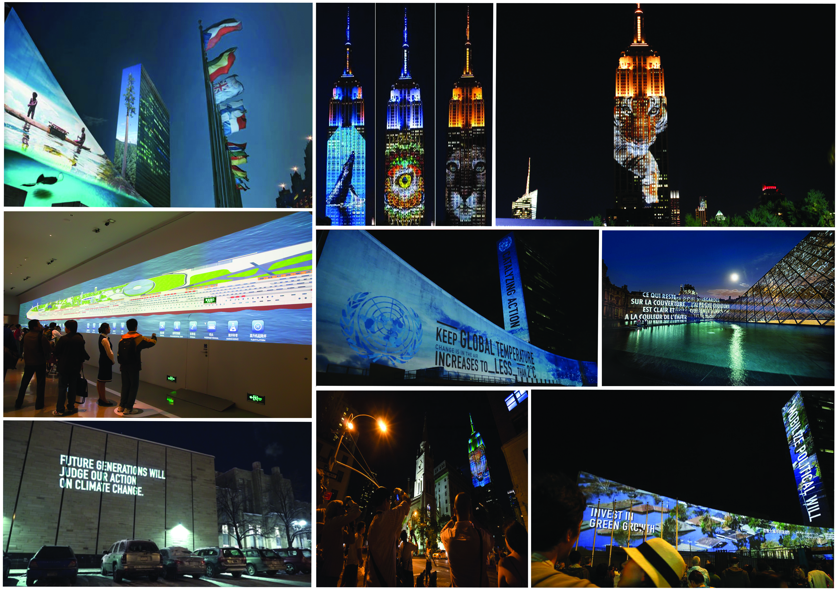
Inspiration

Slide 3
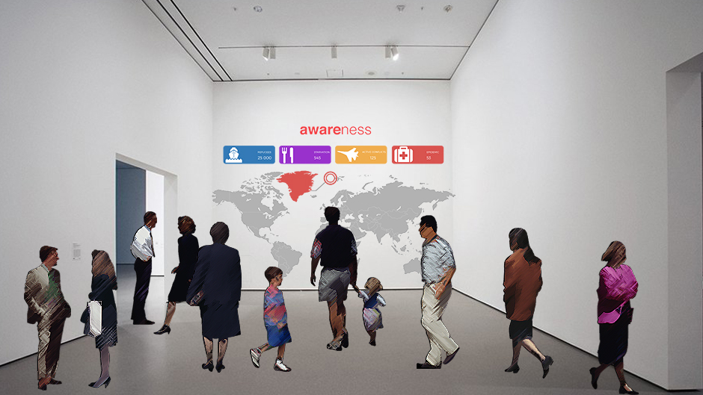
Our concept in its context

